Slide 1

Challenge DATA ENS 2019 - 3 solutions CFM + Napoleon + Neurons
L. Deborde – jan. 2020

Slide 2
Methods
Tools
Feature Engineering
(mostly) Gradient Boosting
(a bit of) Parameter Tuning
I had more success on time series challenges
Python (Jupyter)
Pandas
Scikit-learn
LightGBM -> very fast & handle well categorical features
Personal Computer (Windows, local small CPU)
Notebooks for the submissions are available here: https://github.com/ljmdeb

Slide 3
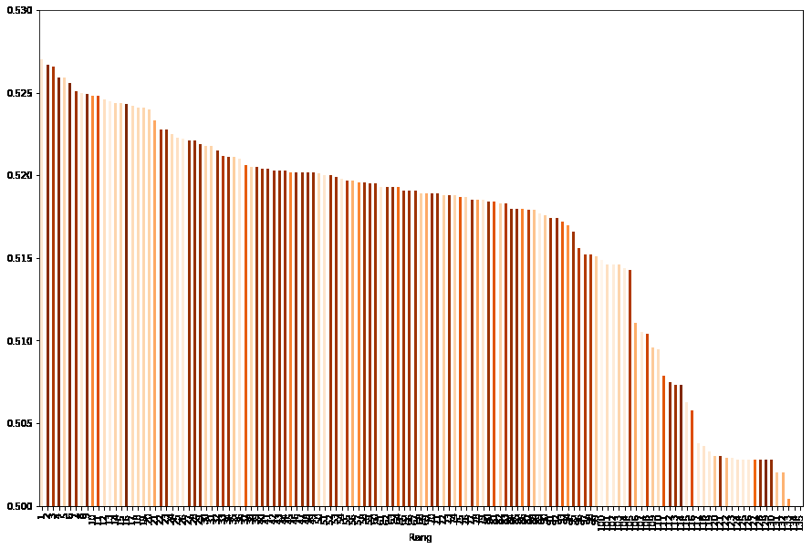
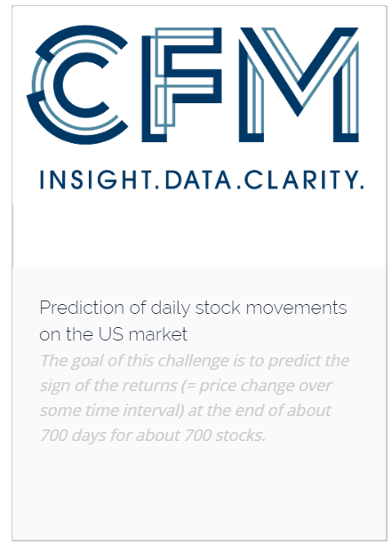
Ranked 2nd* with final score 0,5267
Ranked 2nd on the open leaderboard with the same entry during most of S2, score > 0,53
CFM’s was the most competitive of the 2019 « Challenge data » challenges*
Competition lasted until year end (above, brown colors signify late submissions – 6 of the 10 best ranking final submissions where entered from november on)
*not counting deleted users

Slide 4
Samples pertaining to the same Equity should be correlated Samples pertaining to the same Day should be correlated
Equities : same equities in train and test
Days : different days in train and test
We can use the same equities in train and validation
Ligthgbm : just add Equity identifier as a categorical feature (converted to 0-N integers, as should always be done with Lightgbm)
Without Lightgbm : need to build « Equity » features :
Must use only training values in the model
Possible Idea : use average of features for each equity, computed only on training set
Better idea :
compute average of sign(y) for each equity on the training set
Rational : tendency of a stock to overperform
Add this as a new sample feature -> very powerful predictor (0,5%)
Much better results than using one hot encoding of Equity Code
LightGBM is even more efficient however : Feature dropped after introducing Lightgbm
Days must be different in validation and training : build train-valid-split and cross validation based on days
How to build « Day » features ?
Compute Average (and Standard Deviation) of features on each day
Add those averages (and Std) as new features
Build also « equity normalised » feature (i.e. feature value minus average on day divided by std on day)

Slide 5
The Problem :
We were asked to predict the sign of stock variations during the last half hour of a day, given an number of examples. It’s a binary classification problem of supervised learning.
For the examples, we were actualy given the exact amount of the last half hour variation (not only its sign). So we could have approached the problem as a regression problem (trying to predict the exact end day stock movement, then using the predicted variation to observe its sign). It’s easily understood why this approach is literaly far-fetch (trying to do much to obtain less), hence not promizing. So we did stick to classification here.
The model :
I did compute the following « simple » features for each sample (equity x day):
For each row, Number of NaN (NaN are filled by zeros after counting), Number of Zero variations (before imputing zeros for NaN)
For each row, Sum of variations for the whole day, Sum of variations during last 30 minutes and during penultimate 30 minutes, Last variation (at 15:20)
For each row, Intraday Standard deviation, Skewness & Kurtosis for that day x equity
Exponential moving average length 6 for that day x equity , Relative Strength Index (sum of positive variation H divided by difference between H and sum of negative variations B)
Then I computed the average of those features for each date, as well as Standard deviations of the features by dates, and normalised features (value minus average, divided by std).
Keep also number of equity for each date.
Add an equity feature : tendency of an equity to overperform at end-day
average of sign(y) on training set for this equity
high eplanatory power (but superceded by proper use of categorical features in Lightgbm)
Tune Lgbm by cross validation (8 random split of date range) (useful to avoid chance fit)
Try dropping each feature -> drop when cross validation score improve without feature -> a number of similarly performing results. Best with 6 features (see those in my notebook on github)
Unsuccessfull attempts:
Taking into account (sectorial) correlation between equities (tried ACP data by date or global basis, no improvment on scores)
Stacking with Linear models
Didn’t attempted:
to recognize stocks based on external Stoxx500 data (it would have been cheating)
Regression
How to improve?
In real life : use exogeneous sructured (descriptive, financial, economic) or unstructured (news) data on company / sector / market /economy level

Slide 6
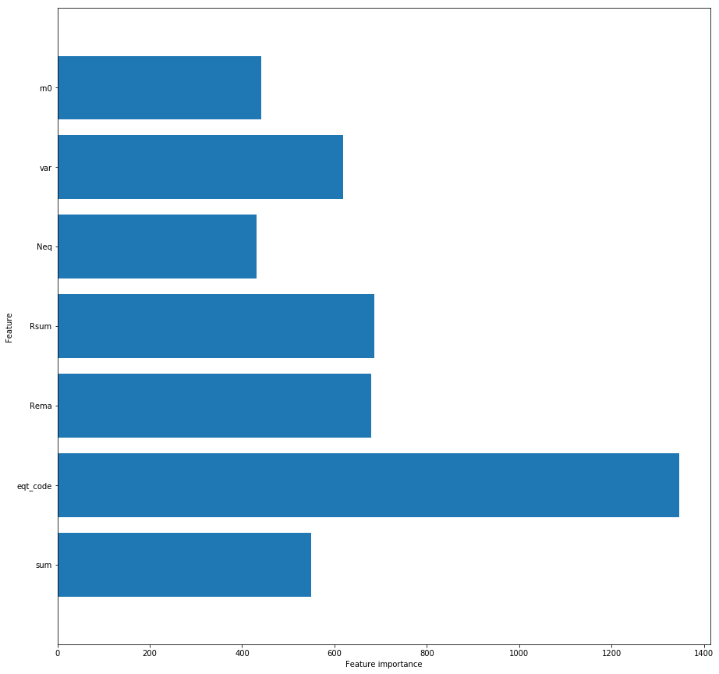
Features importance
1) Sum (and variations taking into account daily average, i.e. market index)
2) Equity code
3) Volatility (Standard deviation of variations)
4) relative number of zeros variations (not counting NaN)
5) number of equities this day (correction to other features)

Slide 7
Nota : A very simple « Expert »rule beats the Benchmark
Simple Expert Rule
Benchmark
« if Market is higher at 15:20 than at opening, it will fall in the last 30 minutes ; if market is lower at 15:20 than at opening, it will rise in the last 30 minutes »
Rules proves to predict correctly the sign of returns in more than 52% of cases (open test set)
Rational : intraday traders cut their positions just before market closes
“The benchmark is a LightGBM boosted trees model, with the following [non default] parameters: objective: None, subsample_freq: 1, learning_rate: 0.05, n_estimators: 500, colsample_bytree: 0.8, subsample: 0.9
This correctly predicts the sign of the returns in typically 51.8 % of the cases.”
July 23, 2019, 7:31 p.m. | Expert rule | Intraday Profit taking | 0.520815
52% w. simple rule, 53% w. complicated features and advanced algorithms -> meager reward for compexity
Complex approach is probably more rewarding with more data (financial variables, dates…)

Slide 8

Benchmark
Prediction of Sharpe ratio for blends of quantitative strategies by Napoleon X
Ranked 1st - final score 0,517
(a bit of a lucky shot : given their score on the open leaderboard, my other late – more planned- submissions would probably have scored around 0,53, still ahead of #2)
Few (20*) competitors : the very technical statement probably deterred people with no finance or math background from participating
Moderate improvement between benchmark and best scores
*not counting deleted users

Slide 9
Mind the arrow of time !
The problem :
We were to predict Sharpe ratio (real value), given a set of example : it’s a regression problem
Optimisation :
to build a model on train, convert given target with the function
Then just optimise on l1 (absolute value of differences)
Mind the date !
As told in the statement, a given time serie appear in up to 50 different lines (with different strategy weights w_{i})
As NOT told in the statement (but as easily verified), time series are different in training set and test set
Data has to be split between different dates for training and validation or the model will be unable to forecast out of time (splitting between train and validation without taking care of that lead to spuriously good-looking models, with low performance on test)

Slide 10
model
Feature used :
Wi, weight of each strategy
Sharpe ratios computed with the statement formula
Portfolio return and volatility
Cumulated performances of each strategy on the whole time serie and on the last 5 periods
Cumlative variations of the ‘L’ macro variables
More details given on my notebook on github
Model :
Best (public) entry with Random Forest (Max_depth=2, metric = mae)
Second best : a random forest and a gradient boosting strictly ex-aequo
An oddity :
I obtained the best score on test with a wide margin (> 2,5%) with a model that had scored significantly less on validation
I choose to select for the competition a less well performing model (still quite ahead of competitors on visible test, but with a lower margin( ~1%), but with homogeneous performance in validation and test -> « select » feature on the Challenge site didn’t function !

Slide 11

Benchmark
Ranked 2nd * - final score 0,44
1st on the public leaderboard at S1 end
*not counting deleted users
Difficult challenge : few participants above benchmark
Many high-ranking deleted users : same person ? Insiders ?

Slide 12
Different kinds of neurons
THE PROBLEM
We are to predict a binary value : it’s obviously a binary classification problem
Only one neuron is present in both training and test set -> Impossible to learn neurone-specific features -> to introduce neuron ID as a (categorical) feature would be a mistake
But scientific litterature tell us there’s (at least) 2 different kind of neurons regarding impulse responses (my thanks to Tristax for informing me of this very useful fact) -> Enabling the model to recognize those different kind of neurons would be highly useful. How to do that ?
Unsuccessfuly tried unsupervised approach (KNN) to identify neuron classes
Fallback plan : building alternate neuron features (by averaging feature values on all raw with the same neuron)
Important notice : as neurons are different in train and test, one has to split by neurons when doing crossvalidation, if one expect to learn neuron features! Failure to recognize this necessity may be the reason why so many participants get bad results

Slide 13
Model :
First we differentiate on each raw (as suggested in the benchmark)
Then on each raw we compute (with numpy) : min, max, sum, standard deviation, skew, kurtosis, 20-quantiles.
Feature importance analysis on a random forest built this way lead us to select 20-quantiles 1,5,10,14,17 (besides min, max, sum, std, kurtosis, for a total of 11 features).
Besides, as explained earlier, we want to build neuron-specific feature. To this end, for each neuron, we compute average of the 11 features for each neurons
… for a total of 22 features.
The random forest was soon replaced by the better performing (sklearn) Gradient boosting.
This model secured a 1st place on the public rank at end of June.
Under pressure from late competition, we later (hastily) :
Replaced the sklearn Gradient Boosting by the better performing and much quicker Lightgbm (handy for optimization)
Added « normalized » features, i.e. row feature values divided by their average on the neuron (idea taken from our participation in the CFM challenge), for a total of 33 features
Albeit those hasty additions had very significantly improved our submissions, we have probably indulged along the way in some measure of guilty glances at test results (aka overfitting), as our best entry loses 3% between public and final score, whereas other good competitors typicaly lose only 1%
a good lesson learned : better to look for a new idea than to overoptimize parameters and feature selection !

